Slide 1
Data Analysis
By Akshat Thakur

Slide 2
Problem Statement
Given , data of some people can you predict the amount the spend on their health care?
Also try exploratory analysis of the provided data to find correlation between different attributes and the target variable.

Slide 3
Visualizing the data (First 4 rows of the data)
Age | Sex | BMI | Children | Smoker/Non-Smoker | Region | Charges
19 | Female | 27.9 | 0 | yes | southwest | 16884.92
18 | Male | 33.77 | 1 | no | southeast | 1725.552
28 | Male | 33 | 3 | no | southeast | 4449.462
33 | Male | 22.705 | 0 | no | northwest | 21984.47

Slide 4
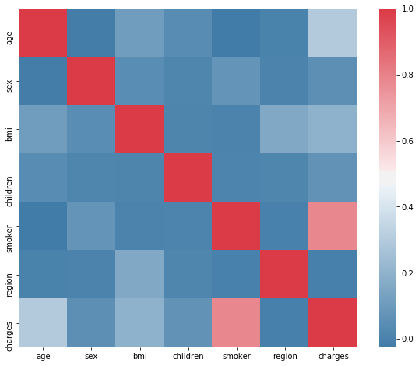
Checking the correlation of various attributes with ‘Charges’.
As we can see from the image above, ‘age’ , ’BMI’ , ’smoker/non-smoker’ are strongly correlated with the charges spent on health care.

Slide 5
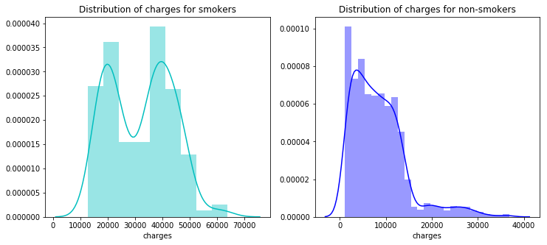
Analysing the distribution of smokers vs non-smokers with charges spent.
.
It is evident form the analysis that smokers spent way more than non smokers for health care charges.

Slide 6
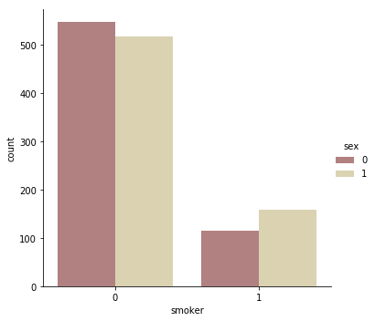
Number of smokers in men and women.
From the bar graph , it is clearly evident that number of combined smokers in both men and women are very high as compared to non smokers in both cases.

Slide 7
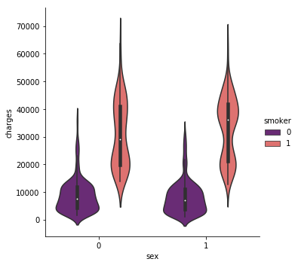
Charges spend by Women vs Men on the basis of smoking
Let’s see how much smokers and non smokers based on gender are spending on healthcare charges
We can see the smokers in both categories are spending more than non smokers.

Slide 8
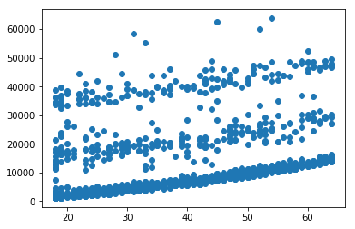
How is age related to charges?
Trying to form a clear picture of how charges vary with age. Analysing the figure , a clear result cannot be drawn because at every particular age there are people with high medical charges and low medical charges. One reason could be ‘Smoking’.

Slide 9
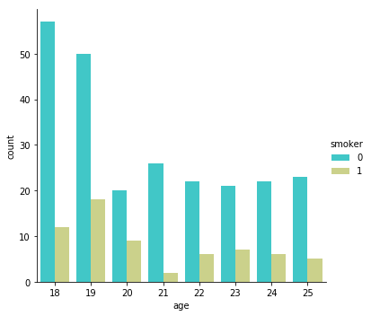
Analyse number of smokers at age 25 and below.
The above data is indicative that smokers at fairly young ages are more as compared to non smokers. Let us try to derive some more data from this result and see how charges spent varies.

Slide 10
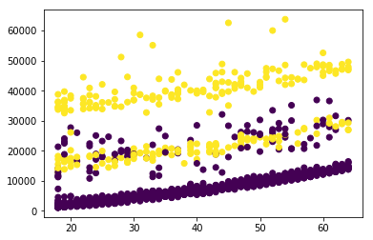
Determining how smoking is related to charges in different age groups.
Her we can see that smokers (colour coded in yellow) at a very young age pay more medical charges as compared to non smokers at same age. And as age increase , there is a linear relationship between age and charges spent.

Slide 11
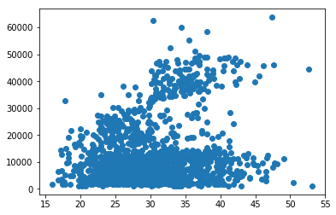
How strongly is BMI related to charges spent.
People having BMI more than 30 start to pay more for health care as BMI above is considered unhealthy. But there are people who pay fairly low for BMI above. Could it be related to age or smoking ? Let’s try to find out.

Slide 12
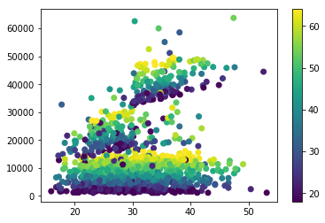
Relationship between BMI and AGE VS Charges
With increasing age , there is no strong relation between charges and BMI. Let us move to next case of BMI and Smoking.

Slide 13
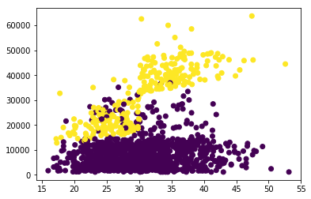
Relationship between SMOKING/NO-SMOKING and BMI VS Charges
Majority of the people who have BMI more than 30 and are smokers pay more for health care. There is a strong correlation between both.

Slide 14
Training the model
Before we begin training a model , let us remove the features that are not strongly correlated with charges.

Slide 15
Does region have any impact on charges?
Region is not related to charges as seen from the heat plot. It is safe to drop it from out dataframe.

Slide 16
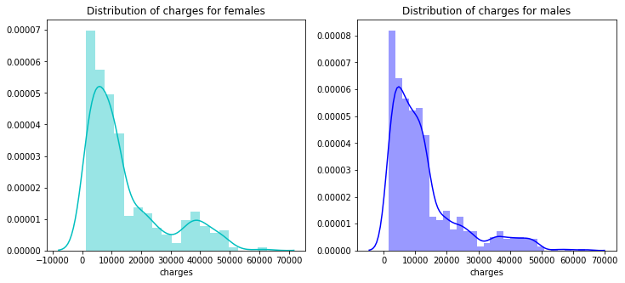
Is sex related to charges?
From the distribution, we can see , sex does not have a direct impact on the charges. We can safely remove it from the dataframe.

Slide 17
Types of models
Simple Linear Regression.
Polynomial Regression.
Ridge Regression (Has Regularization parameter).

Slide 18
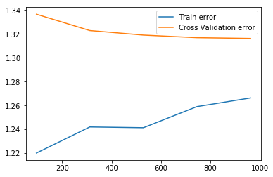
Simple Linear Model
Both training and validation models have high errors. Introducing polynomial features could potentially help.

Slide 19
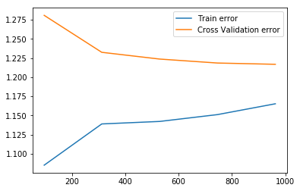
Polynomial Regression
Degree 2 polynomial seems to fit the data. But the model still has some variance. Tuning regularization parameters might help.

Slide 20
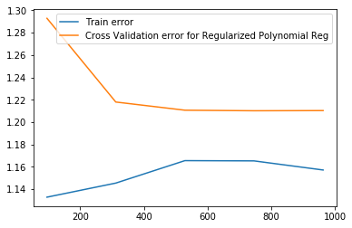
Regularized Polynomial Regression
After regularization train and cross validation error has lower significantly , this will be our final model.

